Slide 1
Geography Markup Language (GML)

Slide 2
What is GML? – Scope
The Geography Markup Language is
a modeling language for geographic information
an encoding for geographic information
designed for the web and web-based services

Slide 3
GML enables a vendor-neutral exchange of spatial data
GML
GIS X
GIS Y
Oracle
File
...

Slide 4
Characteristics
GML
is based on XML technologies
XML, XML Namespaces, XML Schema, Xlinks
supports spatial and non-spatial properties of objects
is open and vendor-neutral
is extensible
supports the definition of profiles (proper subsets) of the full GML capabilities

Slide 5
Characteristics
GML
enables the creation and maintenance of linked geographic application schemas and datasets
increases the ability of organizations to share geographic application schemas and the information they describe
leaves it to implementers to decide whether application schemas and datasets are stored in native GML or whether GML is used only for schema and data transport

Slide 6
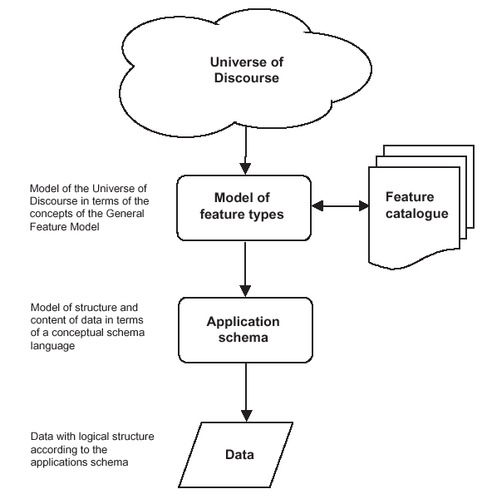
GML Schemas, Application Schemas and Documents
Use a schema language to model geographic information in a GML Application Schema and define rules for such schemas
Define standard elements and types for use in application schemas → GML schemas
Capture real-world objects as data conforming to a GML Application Schema
→ GML Documents
Notes:
This slide describes the generation of application schemas in a pure GML environment.
See slide ...

Slide 7
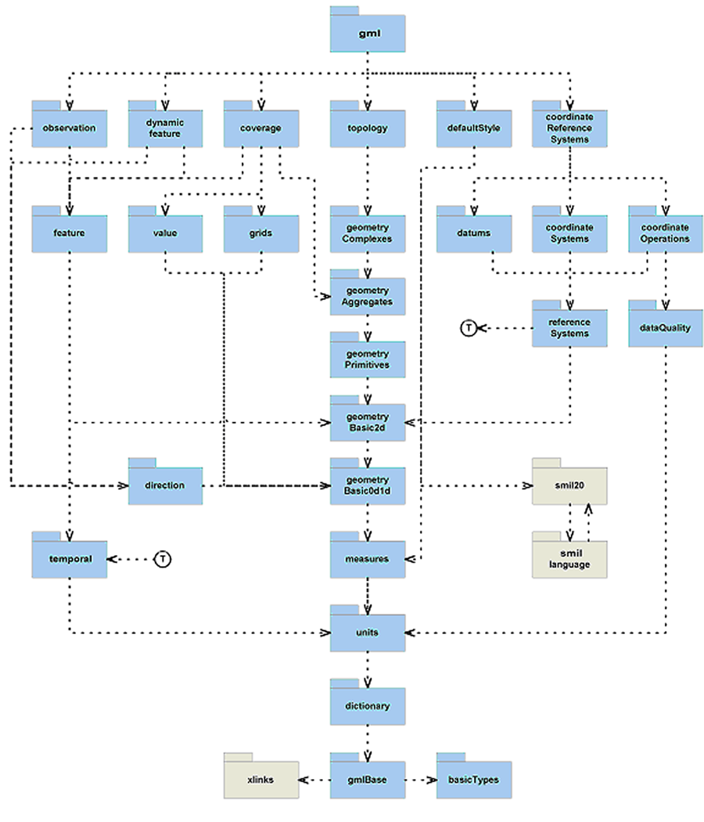
GML Schemas
GML Schemas are horizontal and not focused on a specific application domain
But they can provide common constructs and concepts which may be used by all the different application domains

Slide 8
Modelling Feature Types
Road
name
I95
class
Interstate
centerLine
gml:Curve
maintainer
DOT xyz
Building an information community → reaching consensus about the vocabulary (feature types and their properties)

Slide 9
Modelling Feature Types
<Road gml:id="o.1f75dc">
<name>I95</name>
<class>Interstate</class>
<centerLine>
<gml:Curve>...</gml:Curve>
</centerLine>
<maintainer>DOT xyz</maintainer>
</Road>

Slide 10
Modelling Feature Types
Road
name
I95
class
Interstate
centerLine
gml:Curve
maintainer
auth:Authority
name
xyz
type
DOT
…

Slide 11
Modelling Feature Types
<Road gml:id="o.1f75dc">
<name>I95</name>
<class>Interstate</class>
<centerLine>
<gml:Curve>...</gml:Curve>
</centerLine>
<maintainer>
<auth:Authority gml:id=„o.1f32a3">
<name>xyz</name>
<type>DOT</type>
</auth:Authority>
</maintainer>
</Road>

Slide 12
Enabling the geospatial web
Information Communities publish their Application Schemas (preferably in some sort of registry) so that it can be found, accessed and understood by others
This enables that also the features can have properties whose values are maintained by other authorities
→ a web of geospatial features is created
Traffic
Messages
Roads
Administrative
Boundaries
Buildings
Parcels

Slide 13
... and use GML as the lingua franca of the geospatial web
Standardized Encoding
Standardized Service Interfaces
GML
Internet / Intranet
Web Feature
Server
Web Feature
Server
Web Feature
Server
Web XXX
Server
XML
DB
Oracle
File
...

Slide 14
In summary
Provides a rich set of predefined types for Application Schemas
Has an underlying model that makes processing GML documents easier
Separates presentation and content
Works well in a Web Service environment
A building block of the Geospatial Web

