Slide 1
Spatial and Geospatial Thinking in System Design

Slide 2
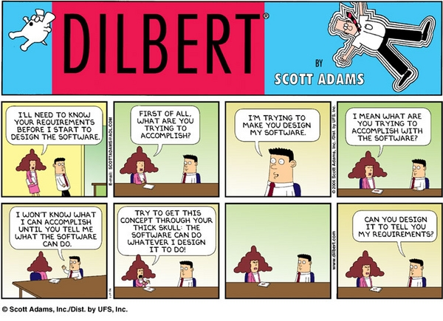

Slide 3
Point! “Requirements” determine what the system does

Slide 4
What makes designing a 911 system different than designing an online auction site?

Slide 5
The normal thinking processes used in the development of non-spatial systems are often insufficient for designing spatial (and geospatial) systems because “normal” software development approaches fail in the treatment space in the design process.
Point! How we think about “space” dictates the system’s requirements.

Slide 6
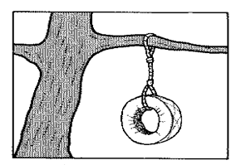
A system is
A system is a group of interrelated components that function together to achieve a desired result.
A simple system. How can requirement's go wrong?
Notes:
Conversion Notes
The definition of system is new to this edition, and was added to reinforce systems thinking.
This is a more concise definition of “information system” than in previous editions. It better reflects what information systems are and do rather than how they are used.
Some books use the term “computer technology.” We prefer the more contemporary term “information technology” as a superset of computer technology.

Slide 7
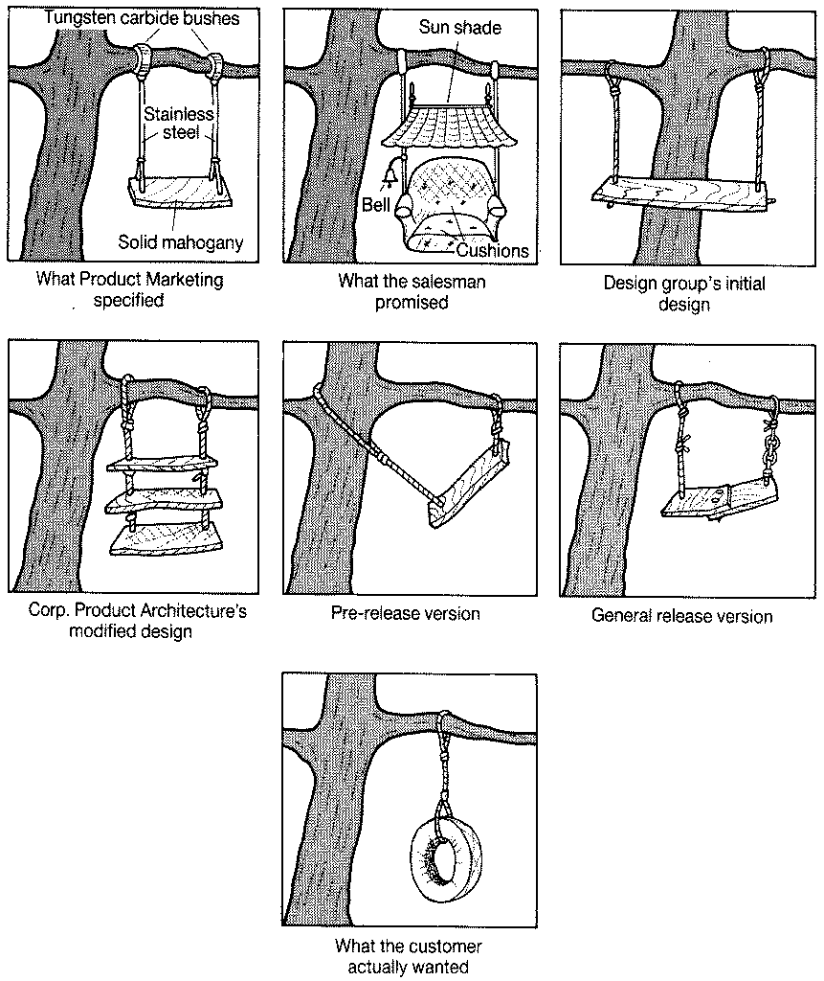
Views of the system

Slide 8
A (geo)spatial system
An arrangement of people, data, processes, and information technology that interact to collect, process, store, and provide information to support the (geo)spatial information needs of an organization.
Point! There are a lot of possibly different views of “space.”
Notes:
Conversion Notes
The definition of system is new to this edition, and was added to reinforce systems thinking.
This is a more concise definition of “information system” than in previous editions. It better reflects what information systems are and do rather than how they are used.
Some books use the term “computer technology.” We prefer the more contemporary term “information technology” as a superset of computer technology.

Slide 9
Spatial thinking
GIS aids spatial thinking.
Geospatial thinking is simply spatial thinking related to the earth.
Point! Our understanding of spatial thinking allows us to externalize system operations by creating representations such as a map or a system that includes spatial processes.

Slide 10
Spatial Thinking
The context is a “frame” that ultimately determines a user’s perspective and need.

Slide 11
It’s never simple
There are actually three frames:
Physical space
Behavioral space
Cognitive space

Slide 12
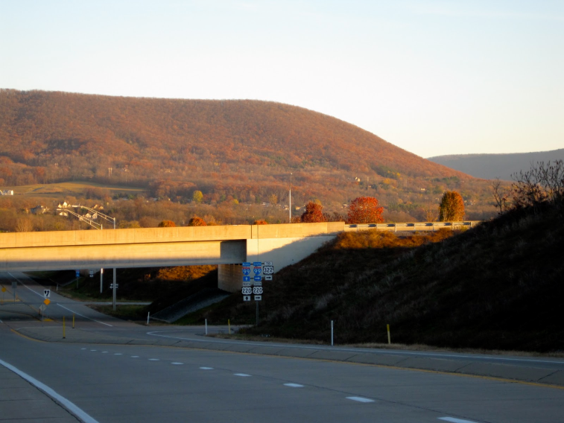
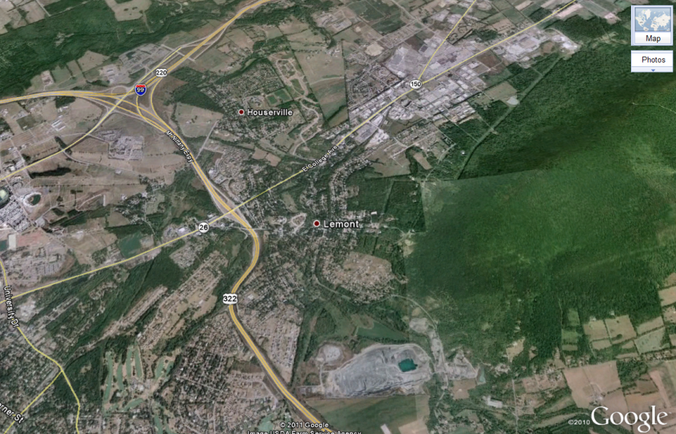
Frames
Physical frame is a window onto material phenomenon in the world.
Involves the ways in which the "world" works.
Anticipating how or why something occurs in nature is largely a scientific process.
An example is how Mount Nittany was formed.

Slide 13
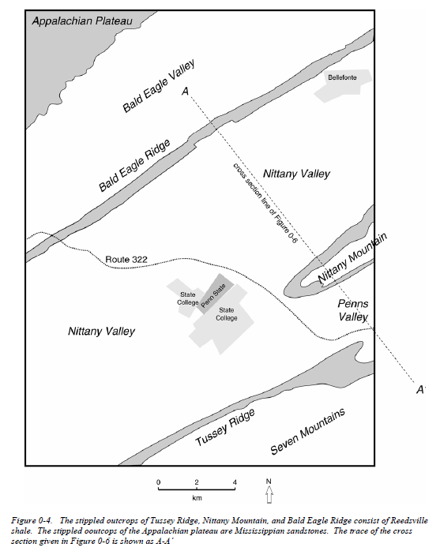
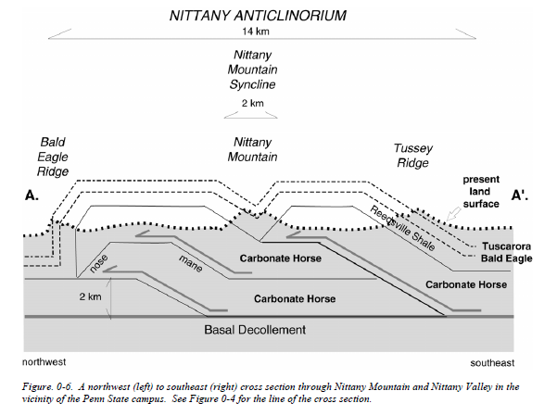

Slide 14
Frames(Cont)
Behavioral frame is a window onto human activity in the physical world.
Anticipating human behavior is largely a heuristic (learned) process.
Exemplified by how we might navigate through State College.

Slide 15
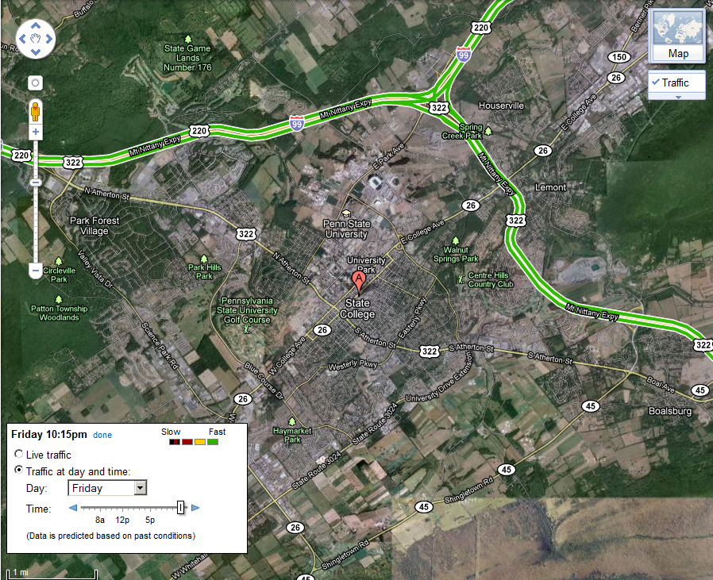

Slide 16
Frames (Cont)
Cognitive frame is a “mental map” of human thought about objects in the physical world.
Seeing this map is an art that depends on skill, creativity, and imagination.
Ideally we could ask the individual what they are thinking but frequently systems do predictive analysis, e.g., where an individual might go for vacation.
An “ask” example is a student’s mental map of the Penn State Campus.

Slide 17
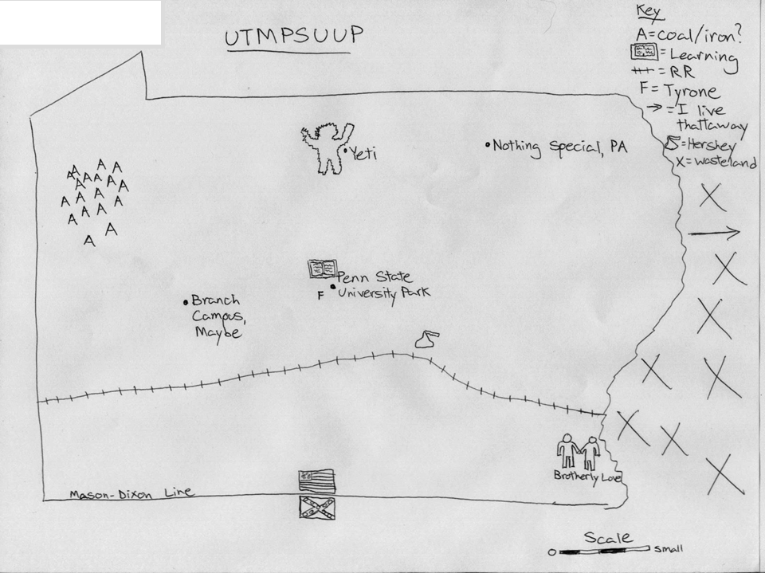
Student Mental Map of Penn State Campus

Slide 18
So?
System developers perceive what they expect to perceive in the behavioral, physical, and cognitive frames
Information is assimilated into existing mental models
Information is often dismissed or ignored

Slide 19
Don’t believe me?

Slide 20
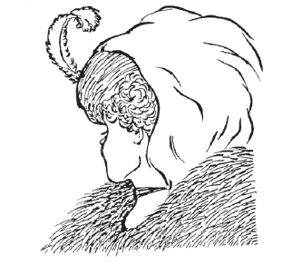
Old woman or a young woman?
D

Slide 21
What do you see?

Slide 22
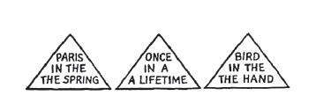
What’s wrong in the figure?
D

Slide 23
At a high level GIS, aids spatial thinking by:
Understand the context
If the data upon which the decision is based are placed into the wrong context, for example, physical space rather than cognitive space, it is likely the decision will be flawed.

Slide 24
Recognize spatial schemes (patterns and shapes)
The system helps the decision maker to retain an image of the simple, and look for it by suppressing objects irrelevant to a task at hand. This allows a decision maker to identify patterns of significance.

Slide 25
Recall previously observed objects
Helps to recall an array of objects that was previously seen.

Slide 26
Integrate observation-based learning
Help synthesizing separately made observations into an integrated whole.
Moves through the data, gathering information from separately observed objects and views, and integrates this information into a coherent image of the area.

Slide 27
Envisioning scenes from different viewpoints
The ability to imagine and coordinate views from different perspectives.
Mental-rotation ability or perspective-taking ability could be relevant to those tasks that involve envisioning what an object, such as a building, would look like if seen from another position.

Slide 28
Conditions & connections: Questions the system designer should consider when collecting requirements to design a geospatial system
Location
Where is it?
Conditions (Site) – What is at the place?
Connections (Situation) – How is the place linked to other places?
Gersmehl and Gersmehl

Slide 29
Gersmehl and Gersmehl (Cont)
Aspects of space
Comparison – Do you need to know how are places are similar or different? Should we compare them?
Aura (Influence) – Is it important what effect(s) a feature has on nearby areas?
Region – Do you need to know if nearby places are similar to each other and can be grouped together?
Hierarchy – Do you need to know if this place fits in a hierarchy of nested areas?
Transition – Do you need to know if the the change between places is abrupt, gradual, or irregular?
Analog – Is it important is distant places have similar situations and therefore may have similar conditions?
Pattern – Are there clusters, strings, rings, waves, other non-random arrangements of features?
Association (Correlation) – Do features tend to occur together (have similar spatial patterns)?
Gersmehl and Gersmehl

Slide 30
Gersmehl and Gersmehl (Cont)
Spatio-temporal – Is it important how spatial features change through time?
Change – Is the change in conditions (e.g. climate, military control, land use, etc.) at a place over time important?
Movement – Is the change in position of something (e.g., train, hurricane, border, etc.) over time important?
Diffusion – Is the change in extent of something (e.g., disease, urban area, rumor, etc.) over time important?
Gersmehl and Gersmehl

Slide 31
Other differences?

Slide 32
Example
A system to find a downtown parking space
Spaces (behavioral, physical, and cognitive)
Where is it?
Conditions (Site) – What is at the place?
Connections (Situation) – How is the place linked to other places?

Slide 33
Example (Cont)
Examine the qualities of the event
Do you need to know how are places are similar or different? Should we compare them?
Is it important what effect(s) a feature has on nearby areas?
Do you need to know if nearby places are similar to each other and can be grouped together?
Do you need to know if this place fits in a hierarchy of nested areas?
Do you need to know if the the change between places is abrupt, gradual, or irregular?
Is it important is distant places have similar situations and therefore may have similar conditions?
Are there clusters, strings, rings, waves, other non-random arrangements of features?
Do features tend to occur together (have similar spatial patterns)?

Slide 34
Example (Cont)
Space-time relationship between the objects and/or event
Is the change in conditions at a place over time important?
Is the change in position of something over time important?
Is the change in extent of something over time important?

