Slide 1
Geographic Fundamentals of Geospatial Intelligence
Lesson 2
Definition and Scope of Geography

Slide 2
Introduction
Purpose
Outline
Kant’s Three Ways of Ordering Knowledge
Geography Defined
Two Sides of the Coin
A Synthesizing Discipline
Why I Love Geography
The Necessity of Geo-Literacy
Summary and Conclusion

Slide 3
Kant’s 3 Ways to Order Knowledge
Topical
Everything about one thing
Chronological
Study change over time and what happened in the past
Focus of Historians
Spatial
Study where things happen, whey they happen there, and how they interact
Focus of Geographers

Slide 4
Definition of Geography
“Geo” means ?
Earth
“Graphy” means ?
To write about or map
Thus Geography literally means ?
To write about the earth
The study of spatial variation, of how—and why—things differ from place to place on the surface of the earth. (textbook definition)
Dr Corson’s defintion
Geography explains how the world works

Slide 5
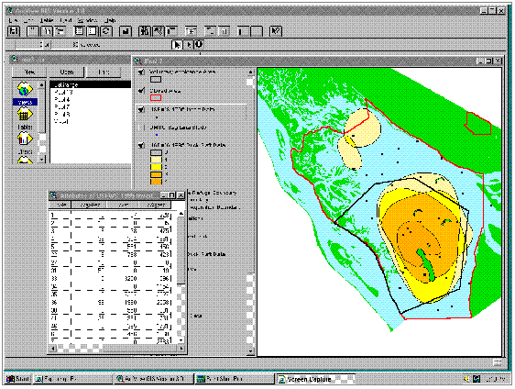
Two Sub-divisions
Physical Geography
Meteorology (weather)
Climatology (climate)
Geomorphology (landforms)
Human Geography
Population Geography
Cultural Geography
Economic Geography
Political Geography
*Geographic Techniques

Slide 6
Geography=Synthesis
Military Science
Biology
Military Geo
Bio-Geography
Economic Geography
Geomorphology
Geology
Economics
GEOGRAPHY
Political Geography
Cultural Geography
Anthropology
Poly Sci

Slide 7
Why I Love Geography
It explains a lot about how the world works.
As a synthesizing discipline it gives me the flexibility to study any interesting subject through the lens of the spatial perspective.
The Geo-Techniques give us powerful tools to help solve the world’s problems.
It has been enormously useful in my military career and provided opportunities outside my military specialty.
It is fascinating and fun.

Slide 8
Geo-Literacy
Surveys show Americans are notoriously “Geo-illiterate”
America is a “hyper-power” and plays a major role in world events
It is sad, dangerous, and undemocratic for a hyper-power to have geo-illiterate citizens
Geo-illiterate geospatial analysts are a potential threat to our national security and by extension the safety of the world

Slide 9
Summary and Conclusion
Summary
Kant’s Three Ways of Ordering Knowledge
Geography Defined
Two Sides of the Coin
A Synthesizing Discipline
Why I Love Geography
The Necessity of Geo-Literacy
Conclusion
Review the Wikipedia article on Geography

